Slide 1
I like monkeys!
Unit 4
Lesson Four - Phonics

Slide 2
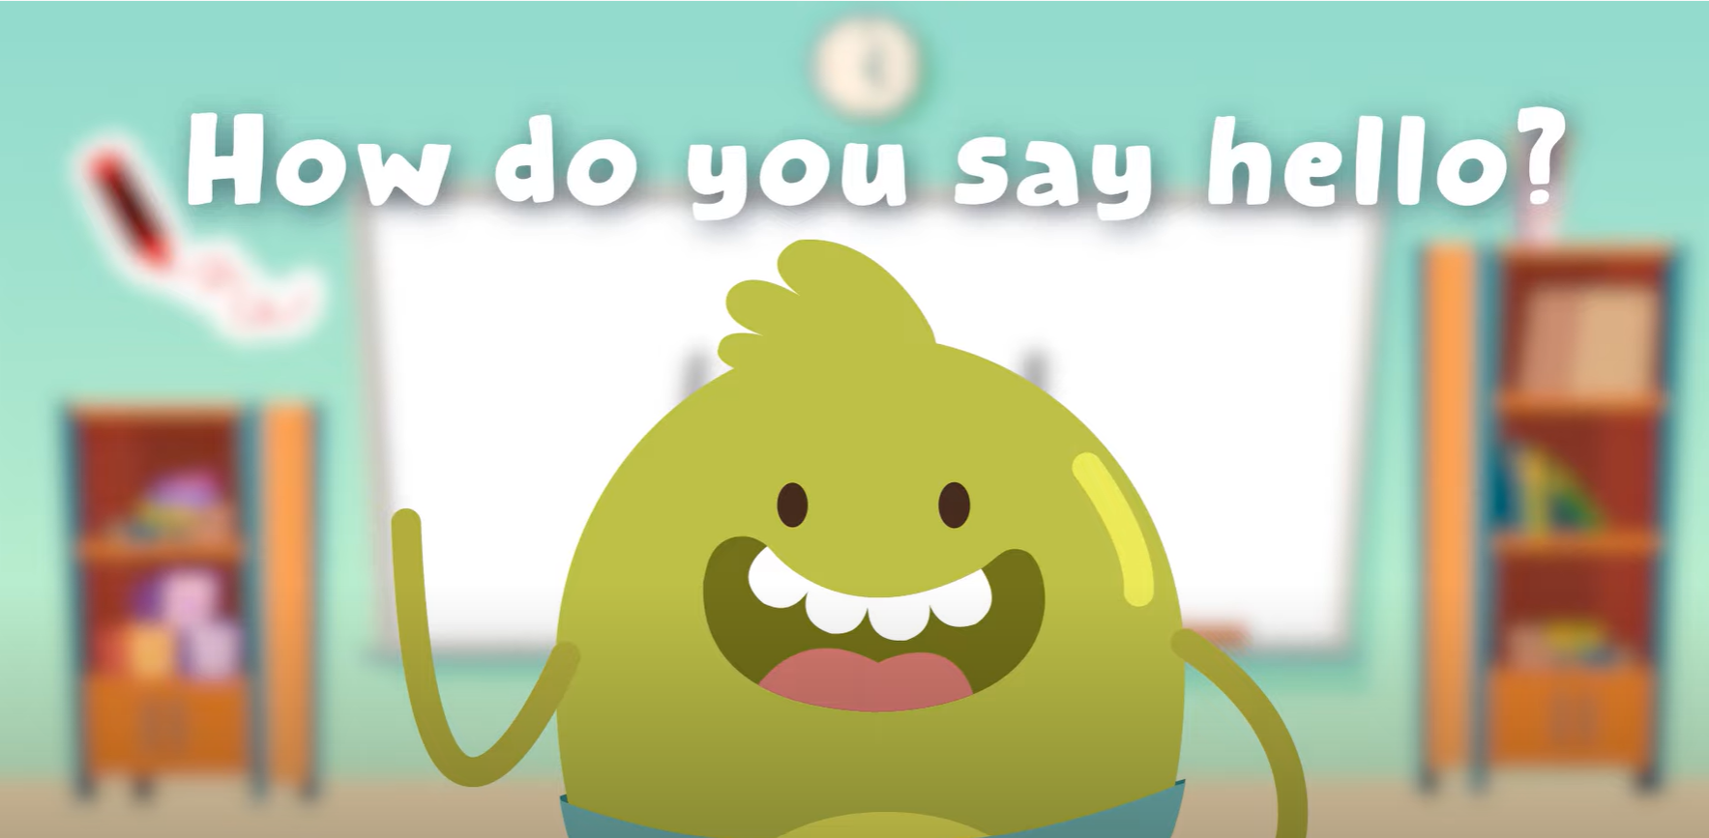
Hello song

Slide 3






Give me five

Slide 4

Game

Slide 5



Listen and Point

Slide 6
Listen and Repeat

Slide 7
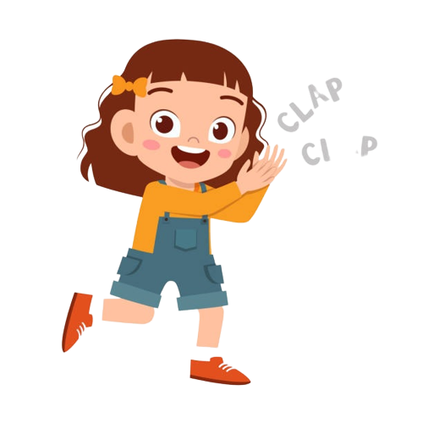
Good job!

Slide 8
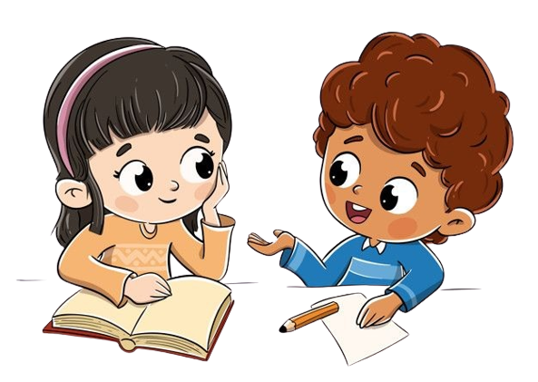
Work in Pairs
Point and Say

Slide 9
Good job!

Slide 10

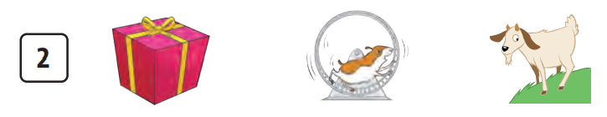
Listen and Circle

Slide 11


Listen and Circle

Slide 12

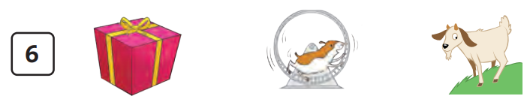
Listen and Circle

Slide 13
Good job!

Slide 14
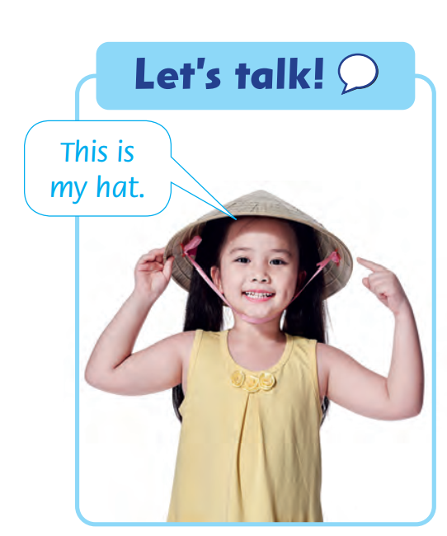
Let’s Talk!
This is my hat.

Slide 15
Work in Pairs
Point and Say

Slide 16
Good job!

Slide 17
Game

Slide 18
Good job!

Slide 19
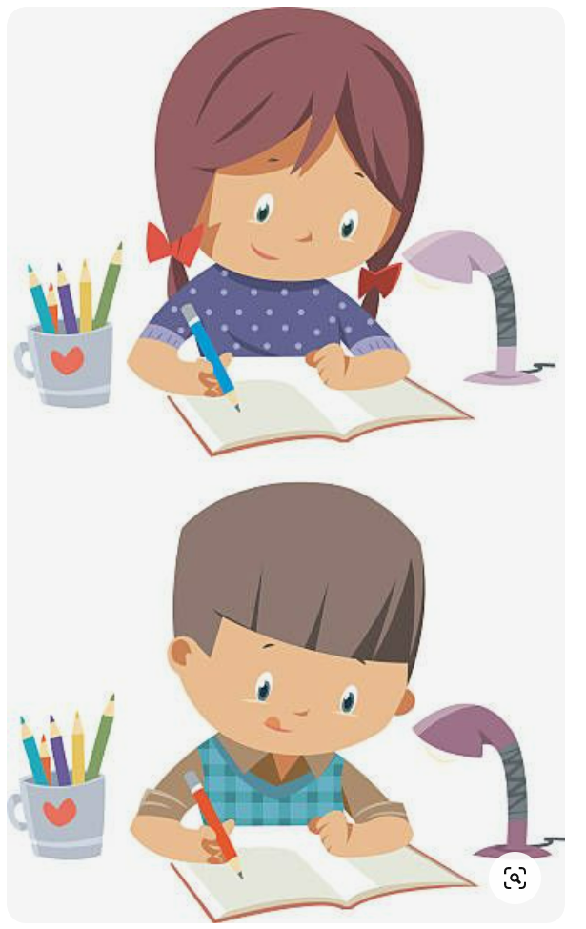
homework

Slide 20


Goodbye!
Please keep this slide for attribution

